Slide 1

Microsoft
Project and Portfolio
Management Solution
Graham Shakespeare
Project Specialist
Microsoft
Yorai Linenberg
Founding Partner
UMT

Slide 2







Project Management Evolution
Project portfolio management
People utilisation and tracking
Collaboration on documents and risks
Microsoft EPM
Greater team
participation
Email Integration
Website
Project 2000
Individual managers
Scheduling and reporting
Up to Project 98
Notes:
Project 4 and 95 and 98 were about personal productivity for the project planner / manager
Project 2000 and 2002 were about Team collaboration
Project 2003 is all about Enterprise Wide Project Management
Colaboration
Resource mgt across projects
Risks and issues

Slide 3
The Portfolio Management Framework:
Select & Deliver the Right Investments…
Portfolio Management
– identify, select and track the optimum mix
100%
Portfolio
Management
50 %
Value Lost
Project Management - deliver on time and on cost
Project
Management
66%
Select the Right Projects
50%
Value Realized
0%
75%
100%
Deliver the Projects Successfully
Notes:
<footer>© 2005 Microsoft Corporation. All rights reserved.
This presentation is for informational purposes only. Microsoft makes no warranties, express or implied, in this summary.
Various research exercises from Gartner and the like, show that project activities do not deliver 100% of value.
Traditionally, people have said that this is all down to not delivering projects on time and on cost – Delivering Projects successfully
However, research now shows that much value is not delivered as the correctr projects are not selected
If it is not aligned with strategy …
Project EPM is all about delivering projects succesffully
On time on cost
Portfolio Serv er is about helping to deliver the Right Projects
Identifying slecting and tracking the optimum mix

Slide 4




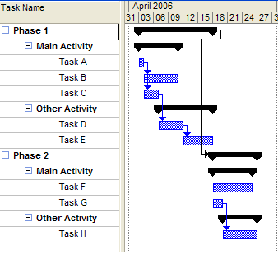

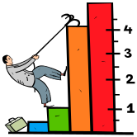
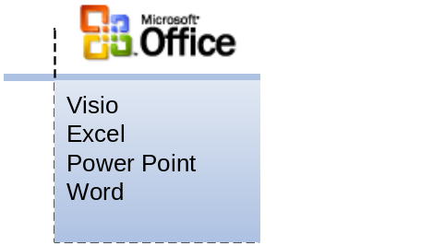
Enterprise Project Management - What’s In It?
Portfolio Server (UMT)
KPI Reports (Business Scorecard Manager)
Project Professional / Project Web Access
Time Sheets
- Hours spent
- % Progress
Outlook
Timesheets
Slice & dice
(OLAP)
Executive
Reports
Web
Access
Finance
Targets /
Results
Outline
Codes
Customer
Satisfaction
Collaboration
Project Professional
Documents
Infopath
Biztalk
Risk Logs
Issue Logs
MS
Dynamics
CRM /
Surveys
Interdependencies
Resource
Pool
Security
Other
Business
Systems
Project Server
WSS
SQLServer
Visual
Studio

Slide 5
Framing the Portfolio & Project Discussion
Portfolio Management answers:
Governance Process Definition

Request Management
Have I selected the right project investments?
Business Case Development

Portfolio Prioritization / Valuation
Do the project investments align with our strategic objectives?
Portfolio Optimization / Selection

Do I have sufficient resources to deliver the selected project investments?
Project Planning
Cost Management

Are my project investments delivering the forecasted benefits?
Resource Management
Business & Technology Stakeholders
Portfolio & Program Management
Time Reporting
Project Management
Project Management answers:
Change Management
Issue Management

Who’s available to staff our new projects?
Risk Management

When will we really finish and what will it cost?
Status Reporting

What am I supposed to be delivering this week?
Earned Value Analysis
Program & Portfolio Reporting

Can we link project data with our front & back office?
Benefits Realization

Slide 6
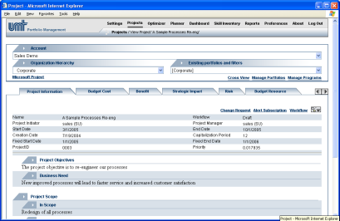
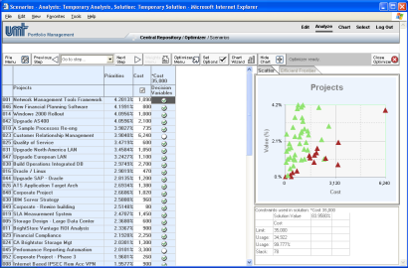
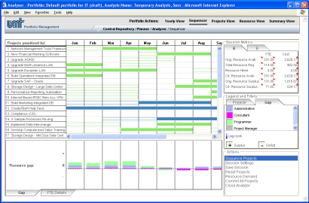
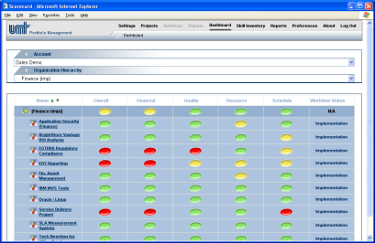



Portfolio Manager Architecture & PPM Process
Phases:
Create
Select
Plan
Manage
Define
Drivers
Prioritize
Drivers
Define
Impact
Statements
Define HR
Competencies
Competency
Availability
Project Phases
Reporting
PPM
Stages:
Initiation
Issues
Select
Portfolio
Design
Risks
Develop
Project
Inventory
Project
Requirements
Analyze
Supply
vs. Demand
Status Reporting
Prioritize
Projects
Optimize
Portfolio
Construct
CR’s
Test
Resource
Optimize Portfolio Schedules
Implement
Milestone
Governance:
Automated Workflow, Approvals and Oversight
Portfolio Builder TM
Portfolio OptimizerTM
Portfolio PlannerTM
Portfolio DashboardTM
Portfolio
Manager™
Software
Suite:
Portfolio PlannerTM
Portfolio DashboardTM
Central Repository
SQL Database
IIS Web Server
Thin Client
Integration
Points:
Notes:
<footer>© 2005 Microsoft Corporation. All rights reserved.
This presentation is for informational purposes only. Microsoft makes no warranties, express or implied, in this summary.

Slide 7
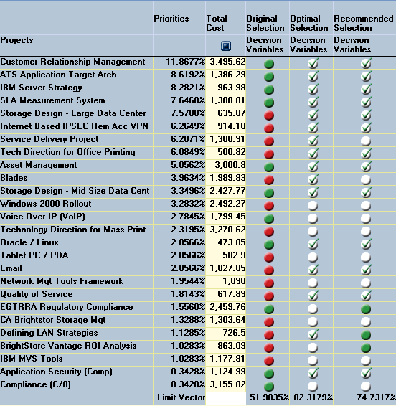
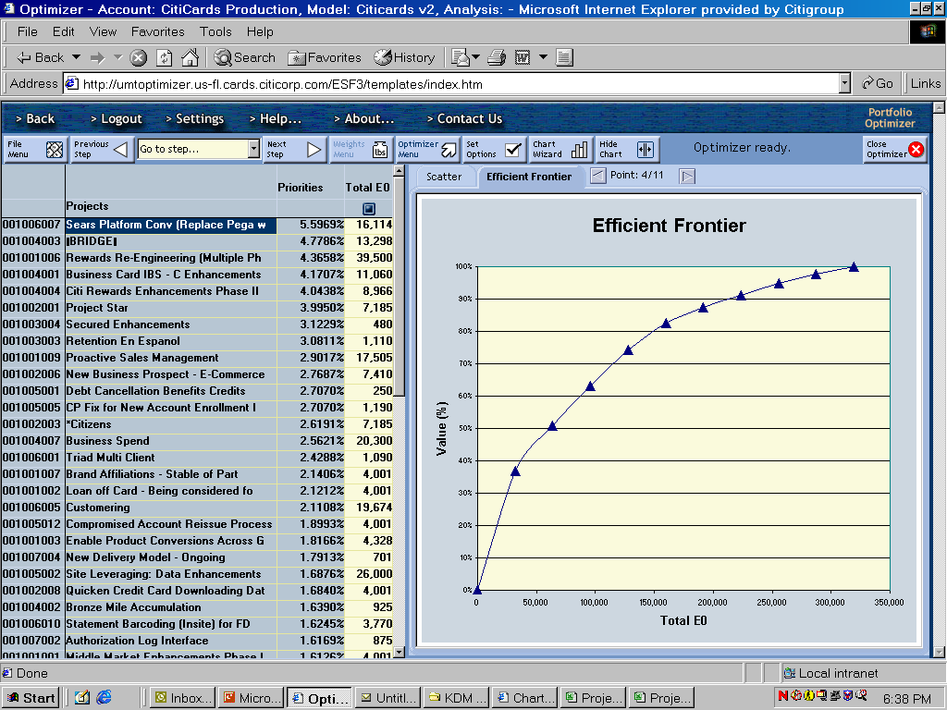
Portfolio Selection:
Maximize Strategic & Financial Value
CLIENT
SUCCESSES
# | Portfolio | Strategic Value | Total EBIT
 | Client’s Original Selection | 51% | $389 M
 | Optimal Selection | 82% | $564 M
 | Recommended Selection | 75% | $526 M
1
2
3
2
3
1
Strategic Value Gain = 24%
EBIT Increase = $137 MM
Notes:
<footer>© 2005 Microsoft Corporation. All rights reserved.
This presentation is for informational purposes only. Microsoft makes no warranties, express or implied, in this summary.

Slide 8
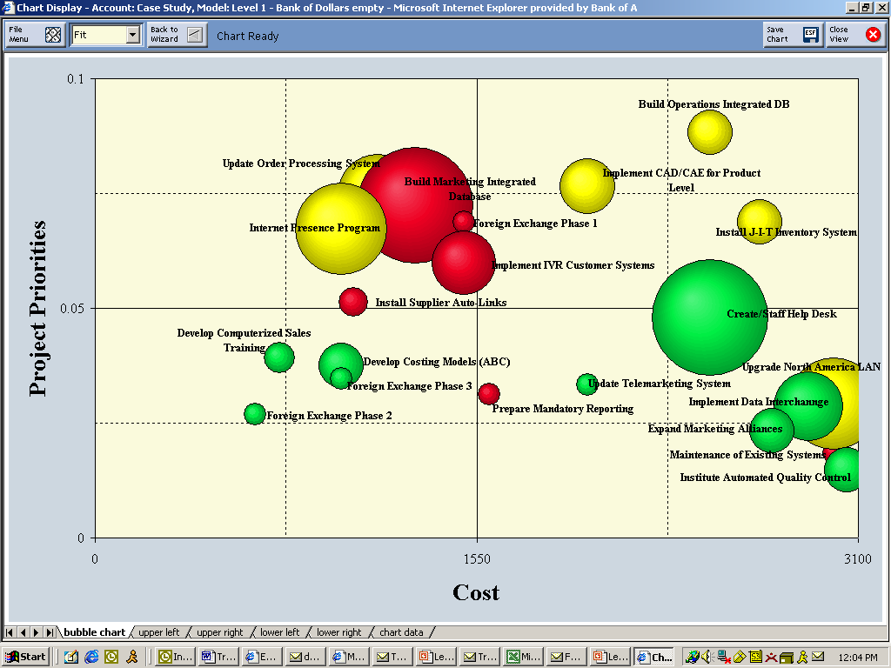
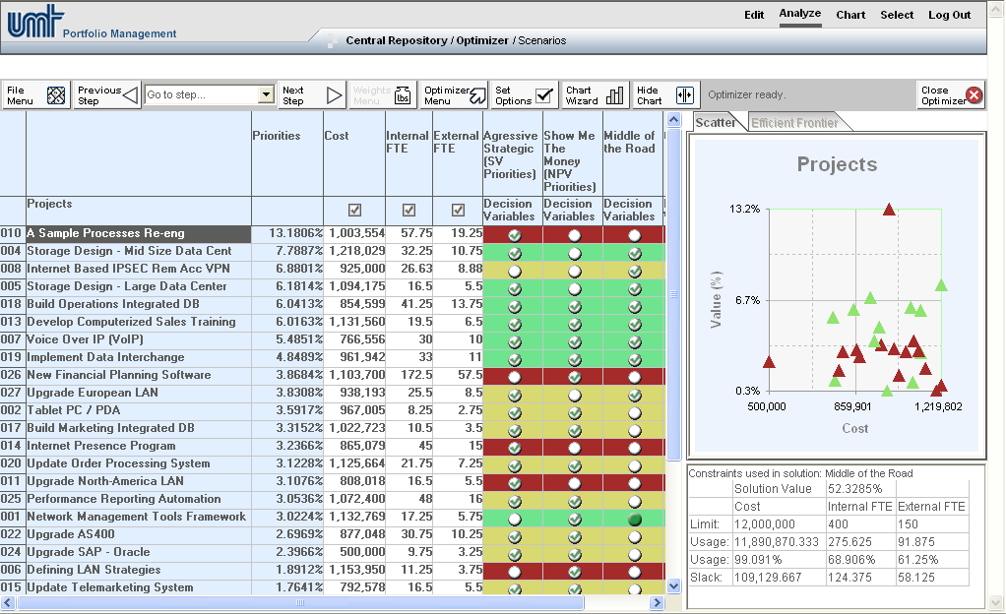
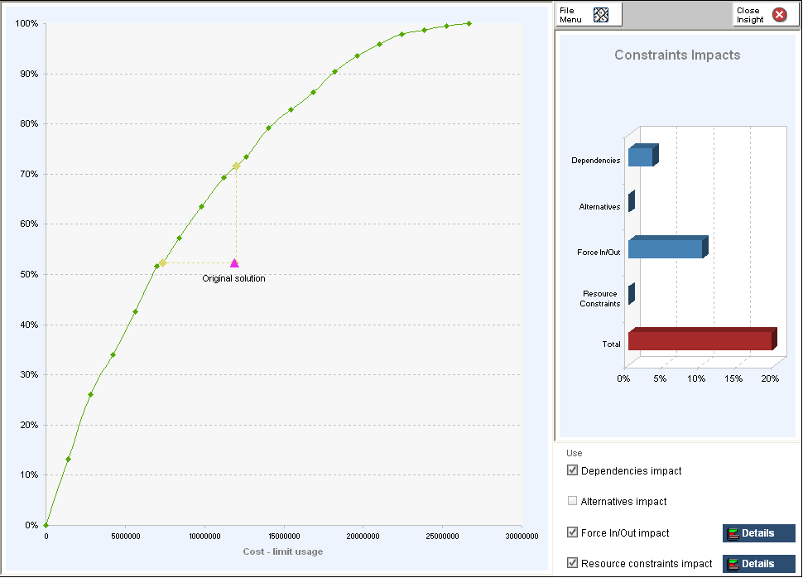

UMT Business Alignment Framework:
Optimize Project Requests
Optimization techniques allow organizations to select portfolios that will deliver the maximum strategic and financial value
Use charting techniques to analyze the portfolio
Optimize the portfolio under varying budgetary constraints
Break constraints and reach the Efficient Frontier
1
2
3
L - Priority - H
Cost
Steps to Success:
Charting Techniques: Gain a better understanding of the portfolio by developing varied charts from derived priority scores and metrics.
Constraint Analysis: Optimize the portfolio under varying budgetary constraints (i.e. cost, resource etc.).
Advanced Portfolio Analysis: Use varied techniques to refine the portfolio selection to identify the project requests that will maximize the portfolio’s strategic and financial value.
Notes:
<footer>© 2005 Microsoft Corporation. All rights reserved.
This presentation is for informational purposes only. Microsoft makes no warranties, express or implied, in this summary.

Slide 9
Questions?
Analyst Reaction: Gartner, AMR, IDC
“[The acquisition] will … put pressure on rival vendors of narrowly targeted portfolio analysis solutions.“ “I would very easily point clients to Portfolio Manager at the new price point”
When we look back at the PPM market five years from now, Microsoft’s acquisition of UMT may stand out as a milestone for the commencement of a new market phase and a richer platform for Microsoft and also a platform on which partners/competitors can build and extend.
Overall, given the company’s channel breadth across the industry spectrum, Microsoft will eventually become a more important strategic source for PPM to nearly all industries.
“[The acquisition] will alter the portfolio management landscape. The impact will be large in the market as Microsoft applies its volume model to this space.”
“The acquisition ... should extend Microsoft Project’s ability to effectively target IT project and portfolio management customers in particular as well as the enterprise [project and portfolio management] market in general.“

Slide 10

© 2005 Microsoft Corporation. All rights reserved.
This presentation is for informational purposes only. Microsoft makes no warranties, express or implied, in this summary.

Slide 11













Rapidly deploy Portfolio Management within the EPM Solution
UMT Portfolio Manager can be implemented independently or within the EPM Solution, to ensure organizations select portfolios that align with their business strategy.
Executives
Resource Managers
Team Members
Project Managers
Executives
Portfolio Analysts
Project Managers
Application Managers
Line of Business Systems
Notes:
<footer>© 2005 Microsoft Corporation. All rights reserved.
This presentation is for informational purposes only. Microsoft makes no warranties, express or implied, in this summary.

Slide 12






















About UMT (www.umt.com)
Global Portfolio Management solution provider with 16+ years experience
Created the UMT Portfolio ManagerTM software suite
Experts in all aspects of the tool and related methodologies
Successfully implemented at the Corporate, Business, and IT levels
Ranked market leader in Portfolio Management tools by Analysts
Offices in New York and London
Notes:
<footer>© 2005 Microsoft Corporation. All rights reserved.
This presentation is for informational purposes only. Microsoft makes no warranties, express or implied, in this summary.
4 Points:
Tool Scope - Today’s version of UMT Portfolio Manager is an end to end Portfolio Management solution from creation of the proposal through management tracking and Application Portfolio Management. The reason this is important is that customers can still use it independently of Project Server. Although we see the primary benefit of using both tools. In situation that there is an entrenched competitor in the project management space it is still feasible to penetrate with a Portfolio level solution that may lead to more in the future and we have one case in which Planview is entrenched at Citibank that we have the possibility to position the product in that way.
Deal structure – MS purchased the UMT entity and spun off the UMT Consulting group to a separate entity so that all the IP is owned by MS today. UMT Consulting Group has two contractual relationships with MS one for selling the product and we have the responsibility to support the product until it goes on to standard Tier 1 and Tier 2 support at MS. UMT is responsible for the knowledge transfer. Today UMT Consulting Group focuses on 4 key areas: Sales, Support, Implementation Services and Training.
Client Type – The types of clients that you see here are not going to stay the same. The latest Webcast that we ran on Tuesday last week had 165 participants and had a wide variety of industries and company sizes.
The industry growth and adoption requires a concerted effort by all partners in the ecosystem to cover the needs so we ‘get it’ that collaboration is going to be a win win situation for all the ecosystem partners.

